Slide 1
SEQUENTIAL CIRCUIT DESIGN
3 BIT COUNTER using D AND JK Flip Flop
LECTURE 9

Slide 2
STEPS FOR SEQUENTIAL CIRCUIT DESIGN
State Diagram
Next State Table
State Reduction And Assignment
Flip Flop Transition Table (FLIP FLOP Selection)
Simplification
Input/output Equations
Implementations of Equation(Logic Diagram)

Slide 3
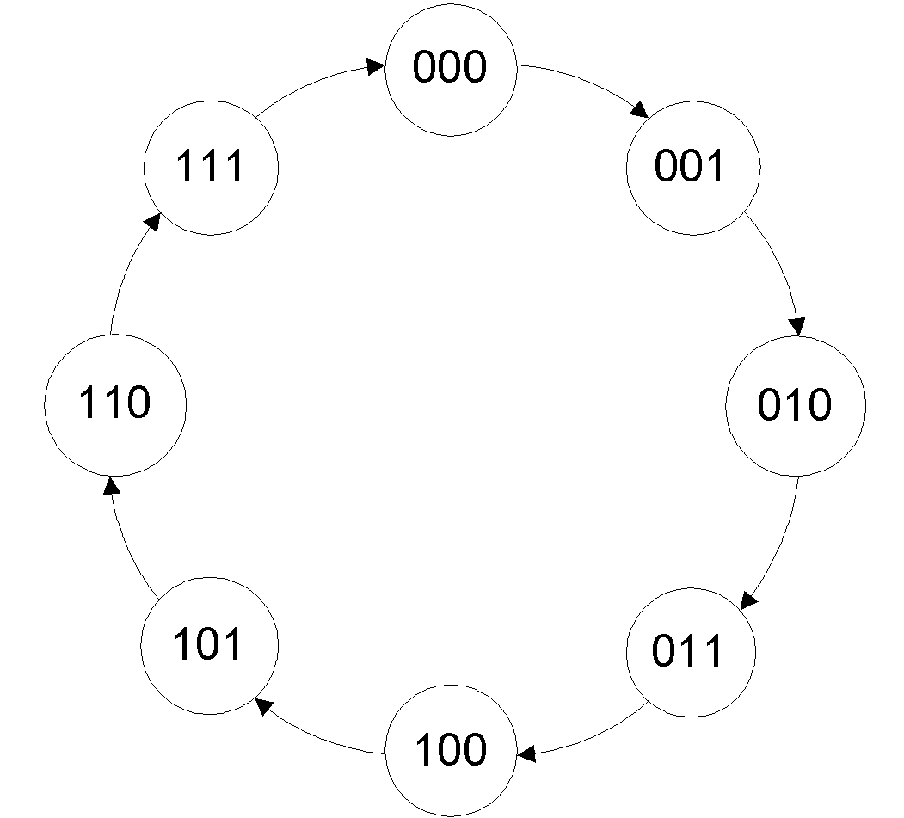
STATE DIAGRAM

Slide 4
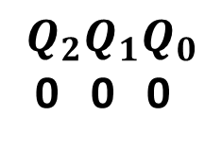
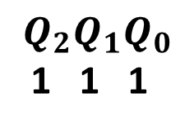
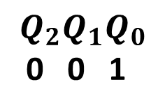
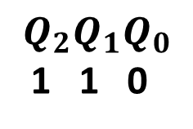
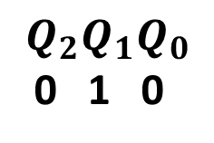
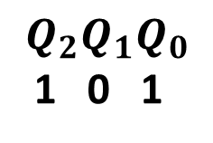
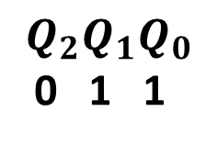
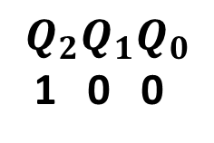
STATE DIAGRAM

Slide 5
NEXT STATE TABLE
PRESENT STATE |  |  | NEXT STATE
0 | 0 | 0 | 0 | 0 | 1
0 | 0 | 1 | 0 | 1 | 0
0 | 1 | 0 | 0 | 1 | 1
0 | 1 | 1 | 1 | 0 | 0
1 | 0 | 0 | 1 | 0 | 1
1 | 0 | 1 | 1 | 1 | 0
1 | 1 | 0 | 1 | 1 | 1
1 | 1 | 1 | 0 | 0 | 0

Slide 6
NEXT STATE TABLE USING D FLIP FLOP
 |  | D
0 | 0 | 0
0 | 1 | 1
1 | 0 | 0
1 | 1 | 1
PRESENT STATE |  |  | NEXT STATE |  |  | D FLIP FLOP INPUTS
0 | 0 | 0 | 0 | 0 | 1
0 | 0 | 1 | 0 | 1 | 0
0 | 1 | 0 | 0 | 1 | 1
0 | 1 | 1 | 1 | 0 | 0
1 | 0 | 0 | 1 | 0 | 1
1 | 0 | 1 | 1 | 1 | 0
1 | 1 | 0 | 1 | 1 | 1
1 | 1 | 1 | 0 | 0 | 0

Slide 7
NEXT STATE TABLE USING D FLIP FLOP
 |  | D
0 | 0 | 0
0 | 1 | 1
1 | 0 | 0
1 | 1 | 1
PRESENT STATE |  |  | NEXT STATE |  |  | D FLIP FLOP INPUTS
0 | 0 | 0 | 0 | 0 | 1 | 0
0 | 0 | 1 | 0 | 1 | 0
0 | 1 | 0 | 0 | 1 | 1
0 | 1 | 1 | 1 | 0 | 0
1 | 0 | 0 | 1 | 0 | 1
1 | 0 | 1 | 1 | 1 | 0
1 | 1 | 0 | 1 | 1 | 1
1 | 1 | 1 | 0 | 0 | 0

Slide 8
NEXT STATE TABLE USING D FLIP FLOP
 |  | D
0 | 0 | 0
0 | 1 | 1
1 | 0 | 0
1 | 1 | 1
PRESENT STATE |  |  | NEXT STATE |  |  | D FLIP FLOP INPUTS
0 | 0 | 0 | 0 | 0 | 1 | 0
0 | 0 | 1 | 0 | 1 | 0 | 0
0 | 1 | 0 | 0 | 1 | 1
0 | 1 | 1 | 1 | 0 | 0
1 | 0 | 0 | 1 | 0 | 1
1 | 0 | 1 | 1 | 1 | 0
1 | 1 | 0 | 1 | 1 | 1
1 | 1 | 1 | 0 | 0 | 0

Slide 9
NEXT STATE TABLE USING D FLIP FLOP
 |  | D
0 | 0 | 0
0 | 1 | 1
1 | 0 | 0
1 | 1 | 1
PRESENT STATE |  |  | NEXT STATE |  |  | D FLIP FLOP INPUTS
0 | 0 | 0 | 0 | 0 | 1 | 0
0 | 0 | 1 | 0 | 1 | 0 | 0
0 | 1 | 0 | 0 | 1 | 1 | 0
0 | 1 | 1 | 1 | 0 | 0
1 | 0 | 0 | 1 | 0 | 1
1 | 0 | 1 | 1 | 1 | 0
1 | 1 | 0 | 1 | 1 | 1
1 | 1 | 1 | 0 | 0 | 0

Slide 10
NEXT STATE TABLE USING D FLIP FLOP
 |  | D
0 | 0 | 0
0 | 1 | 1
1 | 0 | 0
1 | 1 | 1
PRESENT STATE |  |  | NEXT STATE |  |  | D FLIP FLOP INPUTS
0 | 0 | 0 | 0 | 0 | 1 | 0
0 | 0 | 1 | 0 | 1 | 0 | 0
0 | 1 | 0 | 0 | 1 | 1 | 0
0 | 1 | 1 | 1 | 0 | 0 | 1
1 | 0 | 0 | 1 | 0 | 1
1 | 0 | 1 | 1 | 1 | 0
1 | 1 | 0 | 1 | 1 | 1
1 | 1 | 1 | 0 | 0 | 0

Slide 11
NEXT STATE TABLE USING D FLIP FLOP
 |  | D
0 | 0 | 0
0 | 1 | 1
1 | 0 | 0
1 | 1 | 1
PRESENT STATE |  |  | NEXT STATE |  |  | D FLIP FLOP INPUTS
0 | 0 | 0 | 0 | 0 | 1 | 0
0 | 0 | 1 | 0 | 1 | 0 | 0
0 | 1 | 0 | 0 | 1 | 1 | 0
0 | 1 | 1 | 1 | 0 | 0 | 1
1 | 0 | 0 | 1 | 0 | 1 | 1
1 | 0 | 1 | 1 | 1 | 0
1 | 1 | 0 | 1 | 1 | 1
1 | 1 | 1 | 0 | 0 | 0

Slide 12
NEXT STATE TABLE USING D FLIP FLOP
 |  | D
0 | 0 | 0
0 | 1 | 1
1 | 0 | 0
1 | 1 | 1
PRESENT STATE |  |  | NEXT STATE |  |  | D FLIP FLOP INPUTS
0 | 0 | 0 | 0 | 0 | 1 | 0
0 | 0 | 1 | 0 | 1 | 0 | 0
0 | 1 | 0 | 0 | 1 | 1 | 0
0 | 1 | 1 | 1 | 0 | 0 | 1
1 | 0 | 0 | 1 | 0 | 1 | 1
1 | 0 | 1 | 1 | 1 | 0 | 1
1 | 1 | 0 | 1 | 1 | 1
1 | 1 | 1 | 0 | 0 | 0

Slide 13
NEXT STATE TABLE USING D FLIP FLOP
 |  | D
0 | 0 | 0
0 | 1 | 1
1 | 0 | 0
1 | 1 | 1
PRESENT STATE |  |  | NEXT STATE |  |  | D FLIP FLOP INPUTS
0 | 0 | 0 | 0 | 0 | 1 | 0
0 | 0 | 1 | 0 | 1 | 0 | 0
0 | 1 | 0 | 0 | 1 | 1 | 0
0 | 1 | 1 | 1 | 0 | 0 | 1
1 | 0 | 0 | 1 | 0 | 1 | 1
1 | 0 | 1 | 1 | 1 | 0 | 1
1 | 1 | 0 | 1 | 1 | 1 | 1
1 | 1 | 1 | 0 | 0 | 0

Slide 14
NEXT STATE TABLE USING D FLIP FLOP
 |  | D
0 | 0 | 0
0 | 1 | 1
1 | 0 | 0
1 | 1 | 1
PRESENT STATE |  |  | NEXT STATE |  |  | D FLIP FLOP INPUTS
0 | 0 | 0 | 0 | 0 | 1 | 0
0 | 0 | 1 | 0 | 1 | 0 | 0
0 | 1 | 0 | 0 | 1 | 1 | 0
0 | 1 | 1 | 1 | 0 | 0 | 1
1 | 0 | 0 | 1 | 0 | 1 | 1
1 | 0 | 1 | 1 | 1 | 0 | 1
1 | 1 | 0 | 1 | 1 | 1 | 1
1 | 1 | 1 | 0 | 0 | 0 | 0

Slide 15
NEXT STATE TABLE USING D FLIP FLOP
 |  | D
0 | 0 | 0
0 | 1 | 1
1 | 0 | 0
1 | 1 | 1
PRESENT STATE |  |  | NEXT STATE |  |  | D FLIP FLOP INPUTS
0 | 0 | 0 | 0 | 0 | 1 | 0 | 0
0 | 0 | 1 | 0 | 1 | 0 | 0
0 | 1 | 0 | 0 | 1 | 1 | 0
0 | 1 | 1 | 1 | 0 | 0 | 1
1 | 0 | 0 | 1 | 0 | 1 | 1 | 0
1 | 0 | 1 | 1 | 1 | 0 | 1
1 | 1 | 0 | 1 | 1 | 1 | 1
1 | 1 | 1 | 0 | 0 | 0 | 0

Slide 16
NEXT STATE TABLE USING D FLIP FLOP
 |  | D
0 | 0 | 0
0 | 1 | 1
1 | 0 | 0
1 | 1 | 1
PRESENT STATE |  |  | NEXT STATE |  |  | D FLIP FLOP INPUTS
0 | 0 | 0 | 0 | 0 | 1 | 0 | 0
0 | 0 | 1 | 0 | 1 | 0 | 0 | 1
0 | 1 | 0 | 0 | 1 | 1 | 0
0 | 1 | 1 | 1 | 0 | 0 | 1
1 | 0 | 0 | 1 | 0 | 1 | 1 | 0
1 | 0 | 1 | 1 | 1 | 0 | 1 | 1
1 | 1 | 0 | 1 | 1 | 1 | 1
1 | 1 | 1 | 0 | 0 | 0 | 0

Slide 17
NEXT STATE TABLE USING D FLIP FLOP
 |  | D
0 | 0 | 0
0 | 1 | 1
1 | 0 | 0
1 | 1 | 1
PRESENT STATE |  |  | NEXT STATE |  |  | D FLIP FLOP INPUTS
0 | 0 | 0 | 0 | 0 | 1 | 0 | 0
0 | 0 | 1 | 0 | 1 | 0 | 0 | 1
0 | 1 | 0 | 0 | 1 | 1 | 0 | 1
0 | 1 | 1 | 1 | 0 | 0 | 1
1 | 0 | 0 | 1 | 0 | 1 | 1 | 0
1 | 0 | 1 | 1 | 1 | 0 | 1 | 1
1 | 1 | 0 | 1 | 1 | 1 | 1 | 1
1 | 1 | 1 | 0 | 0 | 0 | 0

Slide 18
NEXT STATE TABLE USING D FLIP FLOP
 |  | D
0 | 0 | 0
0 | 1 | 1
1 | 0 | 0
1 | 1 | 1
PRESENT STATE |  |  | NEXT STATE |  |  | D FLIP FLOP INPUTS
0 | 0 | 0 | 0 | 0 | 1 | 0 | 0
0 | 0 | 1 | 0 | 1 | 0 | 0 | 1
0 | 1 | 0 | 0 | 1 | 1 | 0 | 1
0 | 1 | 1 | 1 | 0 | 0 | 1 | 0
1 | 0 | 0 | 1 | 0 | 1 | 1 | 0
1 | 0 | 1 | 1 | 1 | 0 | 1 | 1
1 | 1 | 0 | 1 | 1 | 1 | 1 | 1
1 | 1 | 1 | 0 | 0 | 0 | 0 | 0

Slide 19
NEXT STATE TABLE USING D FLIP FLOP
 |  | D
0 | 0 | 0
0 | 1 | 1
1 | 0 | 0
1 | 1 | 1
PRESENT STATE |  |  | NEXT STATE |  |  | D FLIP FLOP INPUTS
0 | 0 | 0 | 0 | 0 | 1 | 0 | 0 | 1
0 | 0 | 1 | 0 | 1 | 0 | 0 | 1
0 | 1 | 0 | 0 | 1 | 1 | 0 | 1 | 1
0 | 1 | 1 | 0 | 0 | 0 | 1 | 0
1 | 0 | 0 | 1 | 0 | 1 | 1 | 0 | 1
1 | 0 | 1 | 1 | 1 | 0 | 1 | 1
1 | 1 | 0 | 1 | 1 | 1 | 1 | 1 | 1
1 | 1 | 1 | 1 | 0 | 0 | 0 | 0

Slide 20
NEXT STATE TABLE USING D FLIP FLOP
 |  | D
0 | 0 | 0
0 | 1 | 1
1 | 0 | 0
1 | 1 | 1
PRESENT STATE |  |  | NEXT STATE |  |  | D FLIP FLOP INPUTS
0 | 0 | 0 | 0 | 0 | 1 | 0 | 0 | 1
0 | 0 | 1 | 0 | 1 | 0 | 0 | 1 | 0
0 | 1 | 0 | 0 | 1 | 1 | 0 | 1 | 1
0 | 1 | 1 | 0 | 0 | 0 | 1 | 0 | 0
1 | 0 | 0 | 1 | 0 | 1 | 1 | 0 | 1
1 | 0 | 1 | 1 | 1 | 0 | 1 | 1 | 0
1 | 1 | 0 | 1 | 1 | 1 | 1 | 1 | 1
1 | 1 | 1 | 1 | 0 | 0 | 0 | 0 | 0

Slide 21
NEXT STATE TABLE USING D FLIP FLOP
PRESENT STATE |  |  | NEXT STATE |  |  | D FLIP FLOP INPUTS
0 | 0 | 0 | 0 | 0 | 1 | 0 | 0 | 1
0 | 0 | 1 | 0 | 1 | 0 | 0 | 1 | 0
0 | 1 | 0 | 0 | 1 | 1 | 0 | 1 | 1
0 | 1 | 1 | 1 | 0 | 0 | 1 | 0 | 0
1 | 0 | 0 | 1 | 0 | 1 | 1 | 0 | 1
1 | 0 | 1 | 1 | 1 | 0 | 1 | 1 | 0
1 | 1 | 0 | 1 | 1 | 1 | 1 | 1 | 1
1 | 1 | 1 | 0 | 0 | 0 | 0 | 0 | 0

Slide 22
NEXT STATE TABLE USING D FLIP FLOP
PRESENT STATE |  |  | D FLIP FLOP INPUTS
0 | 0 | 0 | 0 | 0 | 1
0 | 0 | 1 | 0 | 1 | 0
0 | 1 | 0 | 0 | 1 | 1
0 | 1 | 1 | 1 | 0 | 0
1 | 0 | 0 | 1 | 0 | 1
1 | 0 | 1 | 1 | 1 | 0
1 | 1 | 0 | 1 | 1 | 1
1 | 1 | 1 | 0 | 0 | 0

Slide 23
SIMPLIFICATION(K-MAP)
PRESENT STATE |  |  | D FLIP FLOP INPUTS
0 | 0 | 0 | 0 | 0 | 1
0 | 0 | 1 | 0 | 1 | 0
0 | 1 | 0 | 0 | 1 | 1
0 | 1 | 1 | 1 | 0 | 0
1 | 0 | 0 | 1 | 0 | 1
1 | 0 | 1 | 1 | 1 | 0
1 | 1 | 0 | 1 | 1 | 1
1 | 1 | 1 | 0 | 0 | 0
 |  | 00 | 01 | 11 | 10
 | 0 | 0 | 0 | 1 | 0
 | 1 | 1 | 1 | 0 | 1

Slide 24

SIMPLIFICATION(K-MAP)
PRESENT STATE |  |  | D FLIP FLOP INPUTS
0 | 0 | 0 | 0 | 0 | 1
0 | 0 | 1 | 0 | 1 | 0
0 | 1 | 0 | 0 | 1 | 1
0 | 1 | 1 | 1 | 0 | 0
1 | 0 | 0 | 1 | 0 | 1
1 | 0 | 1 | 1 | 1 | 0
1 | 1 | 0 | 1 | 1 | 1
1 | 1 | 1 | 0 | 0 | 0
 |  | 00 | 01 | 11 | 10
 | 0 | 0 | 0 | 1 | 0
 | 1 | 1 | 1 | 0 | 1

Slide 25
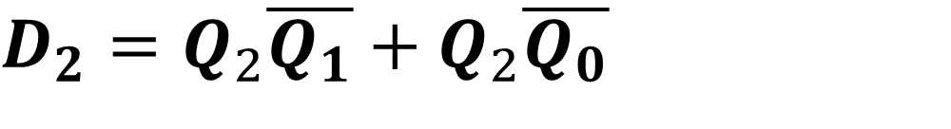
SIMPLIFICATION(K-MAP)
PRESENT STATE |  |  | D FLIP FLOP INPUTS
0 | 0 | 0 | 0 | 0 | 1
0 | 0 | 1 | 0 | 1 | 0
0 | 1 | 0 | 0 | 1 | 1
0 | 1 | 1 | 1 | 0 | 0
1 | 0 | 0 | 1 | 0 | 1
1 | 0 | 1 | 1 | 1 | 0
1 | 1 | 0 | 1 | 1 | 1
1 | 1 | 1 | 0 | 0 | 0
 |  | 00 | 01 | 11 | 10
 | 0 | 0 | 0 | 1 | 0
 | 1 | 1 | 1 | 0 | 1

Slide 26
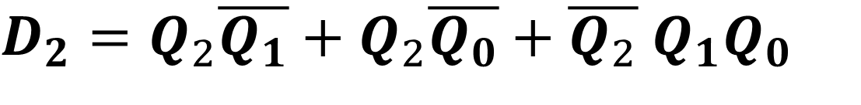
SIMPLIFICATION(K-MAP)
PRESENT STATE |  |  | D FLIP FLOP INPUTS
0 | 0 | 0 | 0 | 0 | 1
0 | 0 | 1 | 0 | 1 | 0
0 | 1 | 0 | 0 | 1 | 1
0 | 1 | 1 | 1 | 0 | 0
1 | 0 | 0 | 1 | 0 | 1
1 | 0 | 1 | 1 | 1 | 0
1 | 1 | 0 | 1 | 1 | 1
1 | 1 | 1 | 0 | 0 | 0
 |  | 00 | 01 | 11 | 10
 | 0 | 0 | 0 | 1 | 0
 | 1 | 1 | 1 | 0 | 1

Slide 27
SIMPLIFICATION(K-MAP)
PRESENT STATE |  |  | D FLIP FLOP INPUTS
0 | 0 | 0 | 0 | 0 | 1
0 | 0 | 1 | 0 | 1 | 0
0 | 1 | 0 | 0 | 1 | 1
0 | 1 | 1 | 1 | 0 | 0
1 | 0 | 0 | 1 | 0 | 1
1 | 0 | 1 | 1 | 1 | 0
1 | 1 | 0 | 1 | 1 | 1
1 | 1 | 1 | 0 | 0 | 0
 |  | 00 | 01 | 11 | 10
 | 0 | 0 | 1 | 0 | 1
 | 1 | 0 | 1 | 0 | 1

Slide 28
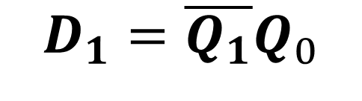
SIMPLIFICATION(K-MAP)
PRESENT STATE |  |  | D FLIP FLOP INPUTS
0 | 0 | 0 | 0 | 0 | 1
0 | 0 | 1 | 0 | 1 | 0
0 | 1 | 0 | 0 | 1 | 1
0 | 1 | 1 | 1 | 0 | 0
1 | 0 | 0 | 1 | 0 | 1
1 | 0 | 1 | 1 | 1 | 0
1 | 1 | 0 | 1 | 1 | 1
1 | 1 | 1 | 0 | 0 | 0
 |  | 00 | 01 | 11 | 10
 | 0 | 0 | 1 | 0 | 1
 | 1 | 0 | 1 | 0 | 1

Slide 29
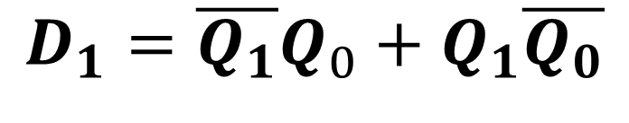

SIMPLIFICATION(K-MAP)
PRESENT STATE |  |  | D FLIP FLOP INPUTS
0 | 0 | 0 | 0 | 0 | 1
0 | 0 | 1 | 0 | 1 | 0
0 | 1 | 0 | 0 | 1 | 1
0 | 1 | 1 | 1 | 0 | 0
1 | 0 | 0 | 1 | 0 | 1
1 | 0 | 1 | 1 | 1 | 0
1 | 1 | 0 | 1 | 1 | 1
1 | 1 | 1 | 0 | 0 | 0
 |  | 00 | 01 | 11 | 10
 | 0 | 0 | 1 | 0 | 1
 | 1 | 0 | 1 | 0 | 1

Slide 30
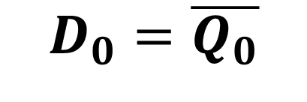
SIMPLIFICATION(K-MAP)
PRESENT STATE |  |  | D FLIP FLOP INPUTS
0 | 0 | 0 | 0 | 0 | 1
0 | 0 | 1 | 0 | 1 | 0
0 | 1 | 0 | 0 | 1 | 1
0 | 1 | 1 | 1 | 0 | 0
1 | 0 | 0 | 1 | 0 | 1
1 | 0 | 1 | 1 | 1 | 0
1 | 1 | 0 | 1 | 1 | 1
1 | 1 | 1 | 0 | 0 | 0
 |  | 00 | 01 | 11 | 10
 | 0 | 1 | 0 | 0 | 1
 | 1 | 1 | 0 | 0 | 1

Slide 31
SIMPLIFICATION(K-MAP)
PRESENT STATE |  |  | D FLIP FLOP INPUTS
0 | 0 | 0 | 0 | 0 | 1
0 | 0 | 1 | 0 | 1 | 0
0 | 1 | 0 | 0 | 1 | 1
0 | 1 | 1 | 1 | 0 | 0
1 | 0 | 0 | 1 | 0 | 1
1 | 0 | 1 | 1 | 1 | 0
1 | 1 | 0 | 1 | 1 | 1
1 | 1 | 1 | 0 | 0 | 0
 |  | 00 | 01 | 11 | 10
 | 0 | 1 | 0 | 0 | 1
 | 1 | 1 | 0 | 0 | 1

Slide 32
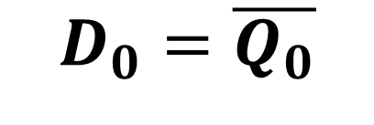

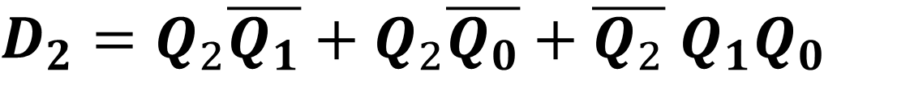
INPUT EQUATIONS

Slide 33
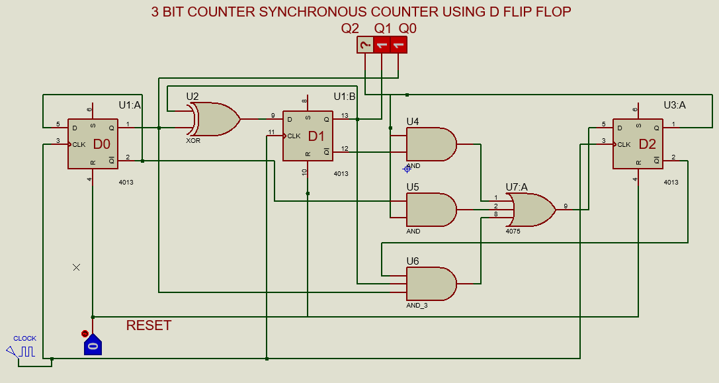
IMPLEMENTATIONS OF EQUATION

Slide 34
NEXT STATE TABLE USING JK FLIP FLOP
PRESENT STATE |  |  | NEXT STATE
0 | 0 | 0 | 0 | 0 | 1
0 | 0 | 1 | 0 | 1 | 0
0 | 1 | 0 | 0 | 1 | 1
0 | 1 | 1 | 1 | 0 | 0
1 | 0 | 0 | 1 | 0 | 1
1 | 0 | 1 | 1 | 1 | 0
1 | 1 | 0 | 1 | 1 | 1
1 | 1 | 1 | 0 | 0 | 0

Slide 35
NEXT STATE TABLE USING JK FLIP FLOP
 |  | J | K
0 | 0 | 0 | X
0 | 1 | 1 | X
1 | 0 | X | 1
1 | 1 | X | 0
PRESENT STATE |  |  | NEXT STATE
0 | 0 | 0 | 0 | 0 | 1
0 | 0 | 1 | 0 | 1 | 0
0 | 1 | 0 | 0 | 1 | 1
0 | 1 | 1 | 1 | 0 | 0
1 | 0 | 0 | 1 | 0 | 1
1 | 0 | 1 | 1 | 1 | 0
1 | 1 | 0 | 1 | 1 | 1
1 | 1 | 1 | 0 | 0 | 0

Slide 36
NEXT STATE TABLE USING JK FLIP FLOP FOR FF2
 |  | J | K
0 | 0 | 0 | X
0 | 1 | 1 | X
1 | 0 | X | 1
1 | 1 | X | 0
PRESENT STATE |  |  | NEXT STATE |  |  | JK FLIP FLOP INPUTS
0 | 0 | 0 | 0 | 0 | 1 | 0 | X
0 | 0 | 1 | 0 | 1 | 0 | 0 | X
0 | 1 | 0 | 0 | 1 | 1 | 0 | X
0 | 1 | 1 | 1 | 0 | 0
1 | 0 | 0 | 1 | 0 | 1
1 | 0 | 1 | 1 | 1 | 0
1 | 1 | 0 | 1 | 1 | 1
1 | 1 | 1 | 0 | 0 | 0

Slide 37
NEXT STATE TABLE USING JK FLIP FLOP FOR FF2
 |  | J | K
0 | 0 | 0 | X
0 | 1 | 1 | X
1 | 0 | X | 1
1 | 1 | X | 0
PRESENT STATE |  |  | NEXT STATE |  |  | JK FLIP FLOP INPUTS
0 | 0 | 0 | 0 | 0 | 1 | 0 | X
0 | 0 | 1 | 0 | 1 | 0 | 0 | X
0 | 1 | 0 | 0 | 1 | 1 | 0 | X
0 | 1 | 1 | 1 | 0 | 0
1 | 0 | 0 | 1 | 0 | 1 | X | 0
1 | 0 | 1 | 1 | 1 | 0 | X | 0
1 | 1 | 0 | 1 | 1 | 1 | X | 0
1 | 1 | 1 | 0 | 0 | 0

Slide 38
NEXT STATE TABLE USING JK FLIP FLOP FOR FF2
 |  | J | K
0 | 0 | 0 | X
0 | 1 | 1 | X
1 | 0 | X | 1
1 | 1 | X | 0
PRESENT STATE |  |  | NEXT STATE |  |  | JK FLIP FLOP INPUTS
0 | 0 | 0 | 0 | 0 | 1 | 0 | X
0 | 0 | 1 | 0 | 1 | 0 | 0 | X
0 | 1 | 0 | 0 | 1 | 1 | 0 | X
0 | 1 | 1 | 1 | 0 | 0 | 1 | X
1 | 0 | 0 | 1 | 0 | 1 | X | 0
1 | 0 | 1 | 1 | 1 | 0 | X | 0
1 | 1 | 0 | 1 | 1 | 1 | X | 0
1 | 1 | 1 | 0 | 0 | 0

Slide 39
NEXT STATE TABLE USING JK FLIP FLOP FOR FF2
 |  | J | K
0 | 0 | 0 | X
0 | 1 | 1 | X
1 | 0 | X | 1
1 | 1 | X | 0
PRESENT STATE |  |  | NEXT STATE |  |  | JK FLIP FLOP INPUTS
0 | 0 | 0 | 0 | 0 | 1 | 0 | X
0 | 0 | 1 | 0 | 1 | 0 | 0 | X
0 | 1 | 0 | 0 | 1 | 1 | 0 | X
0 | 1 | 1 | 1 | 0 | 0 | 1 | X
1 | 0 | 0 | 1 | 0 | 1 | X | 0
1 | 0 | 1 | 1 | 1 | 0 | X | 0
1 | 1 | 0 | 1 | 1 | 1 | X | 0
1 | 1 | 1 | 0 | 0 | 0 | X | 1

Slide 40
NEXT STATE TABLE USING JK FLIP FLOP FOR FF1
 |  | J | K
0 | 0 | 0 | X
0 | 1 | 1 | X
1 | 0 | X | 1
1 | 1 | X | 0
PRESENT STATE |  |  | NEXT STATE |  |  | JK FLIP FLOP INPUTS
0 | 0 | 0 | 0 | 0 | 1 | 0 | X | 0 | X
0 | 0 | 1 | 0 | 1 | 0 | 0 | X
0 | 1 | 0 | 0 | 1 | 1 | 0 | X
0 | 1 | 1 | 1 | 0 | 0 | 1 | X
1 | 0 | 0 | 1 | 0 | 1 | X | 0 | 0 | X
1 | 0 | 1 | 1 | 1 | 0 | X | 0
1 | 1 | 0 | 1 | 1 | 1 | X | 0
1 | 1 | 1 | 0 | 0 | 0 | X | 1

Slide 41
NEXT STATE TABLE USING JK FLIP FLOP FOR FF1
 |  | J | K
0 | 0 | 0 | X
0 | 1 | 1 | X
1 | 0 | X | 1
1 | 1 | X | 0
PRESENT STATE |  |  | NEXT STATE |  |  | JK FLIP FLOP INPUTS
0 | 0 | 0 | 0 | 0 | 1 | 0 | X | 0 | X
0 | 0 | 1 | 0 | 1 | 0 | 0 | X | 1 | X
0 | 1 | 0 | 0 | 1 | 1 | 0 | X
0 | 1 | 1 | 1 | 0 | 0 | 1 | X
1 | 0 | 0 | 1 | 0 | 1 | X | 0 | 0 | X
1 | 0 | 1 | 1 | 1 | 0 | X | 0 | 1 | X
1 | 1 | 0 | 1 | 1 | 1 | X | 0
1 | 1 | 1 | 0 | 0 | 0 | X | 1

Slide 42
NEXT STATE TABLE USING JK FLIP FLOP FOR FF1
 |  | J | K
0 | 0 | 0 | X
0 | 1 | 1 | X
1 | 0 | X | 1
1 | 1 | X | 0
PRESENT STATE |  |  | NEXT STATE |  |  | JK FLIP FLOP INPUTS
0 | 0 | 0 | 0 | 0 | 1 | 0 | X | 0 | X
0 | 0 | 1 | 0 | 1 | 0 | 0 | X | 1 | X
0 | 1 | 0 | 0 | 1 | 1 | 0 | X | X | 0
0 | 1 | 1 | 1 | 0 | 0 | 1 | X
1 | 0 | 0 | 1 | 0 | 1 | X | 0 | 0 | X
1 | 0 | 1 | 1 | 1 | 0 | X | 0 | 1 | X
1 | 1 | 0 | 1 | 1 | 1 | X | 0 | X | 0
1 | 1 | 1 | 0 | 0 | 0 | X | 1

Slide 43
NEXT STATE TABLE USING JK FLIP FLOP FOR FF1
 |  | J | K
0 | 0 | 0 | X
0 | 1 | 1 | X
1 | 0 | X | 1
1 | 1 | X | 0
PRESENT STATE |  |  | NEXT STATE |  |  | JK FLIP FLOP INPUTS
0 | 0 | 0 | 0 | 0 | 1 | 0 | X | 0 | X
0 | 0 | 1 | 0 | 1 | 0 | 0 | X | 1 | X
0 | 1 | 0 | 0 | 1 | 1 | 0 | X | X | 0
0 | 1 | 1 | 1 | 0 | 0 | 1 | X | X | 1
1 | 0 | 0 | 1 | 0 | 1 | X | 0 | 0 | X
1 | 0 | 1 | 1 | 1 | 0 | X | 0 | 1 | X
1 | 1 | 0 | 1 | 1 | 1 | X | 0 | X | 0
1 | 1 | 1 | 0 | 0 | 0 | X | 1 | X | 1

Slide 44
NEXT STATE TABLE USING JK FLIP FLOP FOR FF0
 |  | J | K
0 | 0 | 0 | X
0 | 1 | 1 | X
1 | 0 | X | 1
1 | 1 | X | 0
PRESENT STATE |  |  | NEXT STATE |  |  | JK FLIP FLOP INPUTS
0 | 0 | 0 | 0 | 0 | 1 | 0 | X | 0 | X | 1 | X
0 | 0 | 1 | 0 | 1 | 0 | 0 | X | 1 | X
0 | 1 | 0 | 0 | 1 | 1 | 0 | X | X | 0 | 1 | X
0 | 1 | 1 | 1 | 0 | 0 | 1 | X | X | 1
1 | 0 | 0 | 1 | 0 | 1 | X | 0 | 0 | X | 1 | X
1 | 0 | 1 | 1 | 1 | 0 | X | 0 | 1 | X
1 | 1 | 0 | 1 | 1 | 1 | X | 0 | X | 0 | 1 | X
1 | 1 | 1 | 0 | 0 | 0 | X | 1 | X | 1

Slide 45
NEXT STATE TABLE USING JK FLIP FLOP FOR FF0
 |  | J | K
0 | 0 | 0 | X
0 | 1 | 1 | X
1 | 0 | X | 1
1 | 1 | X | 0
PRESENT STATE |  |  | NEXT STATE |  |  | JK FLIP FLOP INPUTS
0 | 0 | 0 | 0 | 0 | 1 | 0 | X | 0 | X | 1 | X
0 | 0 | 1 | 0 | 1 | 0 | 0 | X | 1 | X | X | 1
0 | 1 | 0 | 0 | 1 | 1 | 0 | X | X | 0 | 1 | X
0 | 1 | 1 | 1 | 0 | 0 | 1 | X | X | 1 | X | 1
1 | 0 | 0 | 1 | 0 | 1 | X | 0 | 0 | X | 1 | X
1 | 0 | 1 | 1 | 1 | 0 | X | 0 | 1 | X | X | 1
1 | 1 | 0 | 1 | 1 | 1 | X | 0 | X | 0 | 1 | X
1 | 1 | 1 | 0 | 0 | 0 | X | 1 | X | 1 | X | 1

Slide 46
NEXT STATE TABLE USING JK FLIP FLOP FOR FF1
PRESENT STATE |  |  | JK FLIP FLOP INPUTS
0 | 0 | 0 | 0 | X | 0 | X | 1 | X
0 | 0 | 1 | 0 | X | 1 | X | X | 1
0 | 1 | 0 | 0 | X | X | 0 | 1 | X
0 | 1 | 1 | 1 | X | X | 1 | X | 1
1 | 0 | 0 | X | 0 | 0 | X | 1 | X
1 | 0 | 1 | X | 0 | 1 | X | X | 1
1 | 1 | 0 | X | 0 | X | 0 | 1 | X
1 | 1 | 1 | X | 1 | X | 1 | X | 1

Slide 47

SIMPLIFICATION(K-MAP)
PRESENT STATE |  |  | JK FLIP FLOP INPUTS
0 | 0 | 0 | 0 | X | 0 | X | 1 | X
0 | 0 | 1 | 0 | X | 1 | X | X | 1
0 | 1 | 0 | 0 | X | X | 0 | 1 | X
0 | 1 | 1 | 1 | X | X | 1 | X | 1
1 | 0 | 0 | X | 0 | 0 | X | 1 | X
1 | 0 | 1 | X | 0 | 1 | X | X | 1
1 | 1 | 0 | X | 0 | X | 0 | 1 | X
1 | 1 | 1 | X | 1 | X | 1 | X | 1
 |  | 00 | 01 | 11 | 10
 | 0 | 0 | 0 | 1 | 0
 | 1 | X | X | X | X

Slide 48
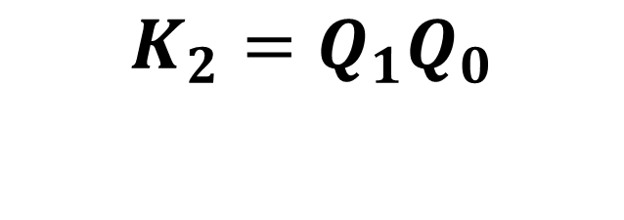
SIMPLIFICATION(K-MAP)
PRESENT STATE |  |  | JK FLIP FLOP INPUTS
0 | 0 | 0 | 0 | X | 0 | X | 1 | X
0 | 0 | 1 | 0 | X | 1 | X | X | 1
0 | 1 | 0 | 0 | X | X | 0 | 1 | X
0 | 1 | 1 | 1 | X | X | 1 | X | 1
1 | 0 | 0 | X | 0 | 0 | X | 1 | X
1 | 0 | 1 | X | 0 | 1 | X | X | 1
1 | 1 | 0 | X | 0 | X | 0 | 1 | X
1 | 1 | 1 | X | 1 | X | 1 | X | 1
 |  | 00 | 01 | 11 | 10
 | 0 | X | X | X | X
 | 1 | 0 | 0 | 1 | 0

Slide 49

SIMPLIFICATION(K-MAP)
PRESENT STATE |  |  | JK FLIP FLOP INPUTS
0 | 0 | 0 | 0 | X | 0 | X | 1 | X
0 | 0 | 1 | 0 | X | 1 | X | X | 1
0 | 1 | 0 | 0 | X | X | 0 | 1 | X
0 | 1 | 1 | 1 | X | X | 1 | X | 1
1 | 0 | 0 | X | 0 | 0 | X | 1 | X
1 | 0 | 1 | X | 0 | 1 | X | X | 1
1 | 1 | 0 | X | 0 | X | 0 | 1 | X
1 | 1 | 1 | X | 1 | X | 1 | X | 1
 |  | 00 | 01 | 11 | 10
 | 0 | 0 | 1 | X | X
 | 1 | 0 | 1 | X | X

Slide 50

SIMPLIFICATION(K-MAP)
PRESENT STATE |  |  | JK FLIP FLOP INPUTS
0 | 0 | 0 | 0 | X | 0 | X | 1 | X
0 | 0 | 1 | 0 | X | 1 | X | X | 1
0 | 1 | 0 | 0 | X | X | 0 | 1 | X
0 | 1 | 1 | 1 | X | X | 1 | X | 1
1 | 0 | 0 | X | 0 | 0 | X | 1 | X
1 | 0 | 1 | X | 0 | 1 | X | X | 1
1 | 1 | 0 | X | 0 | X | 0 | 1 | X
1 | 1 | 1 | X | 1 | X | 1 | X | 1
 |  | 00 | 01 | 11 | 10
 | 0 | X | X | 1 | 0
 | 1 | X | X | 1 | 0

Slide 51

SIMPLIFICATION(K-MAP)
PRESENT STATE |  |  | JK FLIP FLOP INPUTS
0 | 0 | 0 | 0 | X | 0 | X | 1 | X
0 | 0 | 1 | 0 | X | 1 | X | X | 1
0 | 1 | 0 | 0 | X | X | 0 | 1 | X
0 | 1 | 1 | 1 | X | X | 1 | X | 1
1 | 0 | 0 | X | 0 | 0 | X | 1 | X
1 | 0 | 1 | X | 0 | 1 | X | X | 1
1 | 1 | 0 | X | 0 | X | 0 | 1 | X
1 | 1 | 1 | X | 1 | X | 1 | X | 1
 |  | 00 | 01 | 11 | 10
 | 0 | 1 | X | X | 1
 | 1 | 1 | X | X | 1

Slide 52

SIMPLIFICATION(K-MAP)
PRESENT STATE |  |  | JK FLIP FLOP INPUTS
0 | 0 | 0 | 0 | X | 0 | X | 1 | X
0 | 0 | 1 | 0 | X | 1 | X | X | 1
0 | 1 | 0 | 0 | X | X | 0 | 1 | X
0 | 1 | 1 | 1 | X | X | 1 | X | 1
1 | 0 | 0 | X | 0 | 0 | X | 1 | X
1 | 0 | 1 | X | 0 | 1 | X | X | 1
1 | 1 | 0 | X | 0 | X | 0 | 1 | X
1 | 1 | 1 | X | 1 | X | 1 | X | 1
 |  | 00 | 01 | 11 | 10
 | 0 | X | 1 | 1 | X
 | 1 | X | 1 | 1 | X

Slide 53

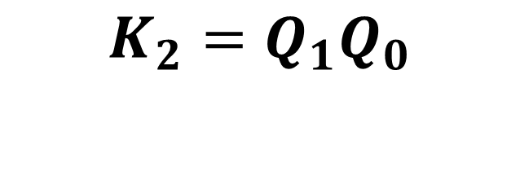




INPUT EQUATIONS

Slide 54
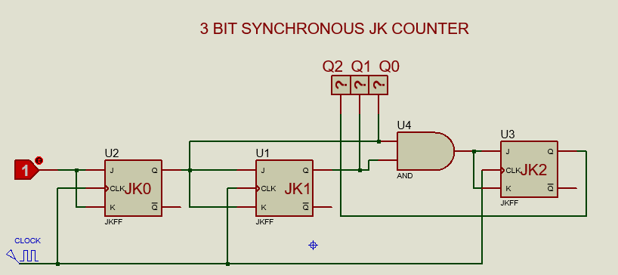
IMPLEMENTATIONS OF EQUATION

